Slide 1
FINAL PROJECT
Toni Vlašić
Đorđe Vulević
Bruno Maleš

Slide 2
agenda
FUNCTIONALITIES
UML
SEQUENCE DIAGRAM
DEMO

Slide 3
Functionalities
ADDING FOOD AND RECIPES
LOGGING DAILY FOOD INTAKE
CALCULATING CALORIE GOALS

Slide 4
PATTERNS
3
MVC
OBSERVER
DECORATOR
FACTORY

Slide 5
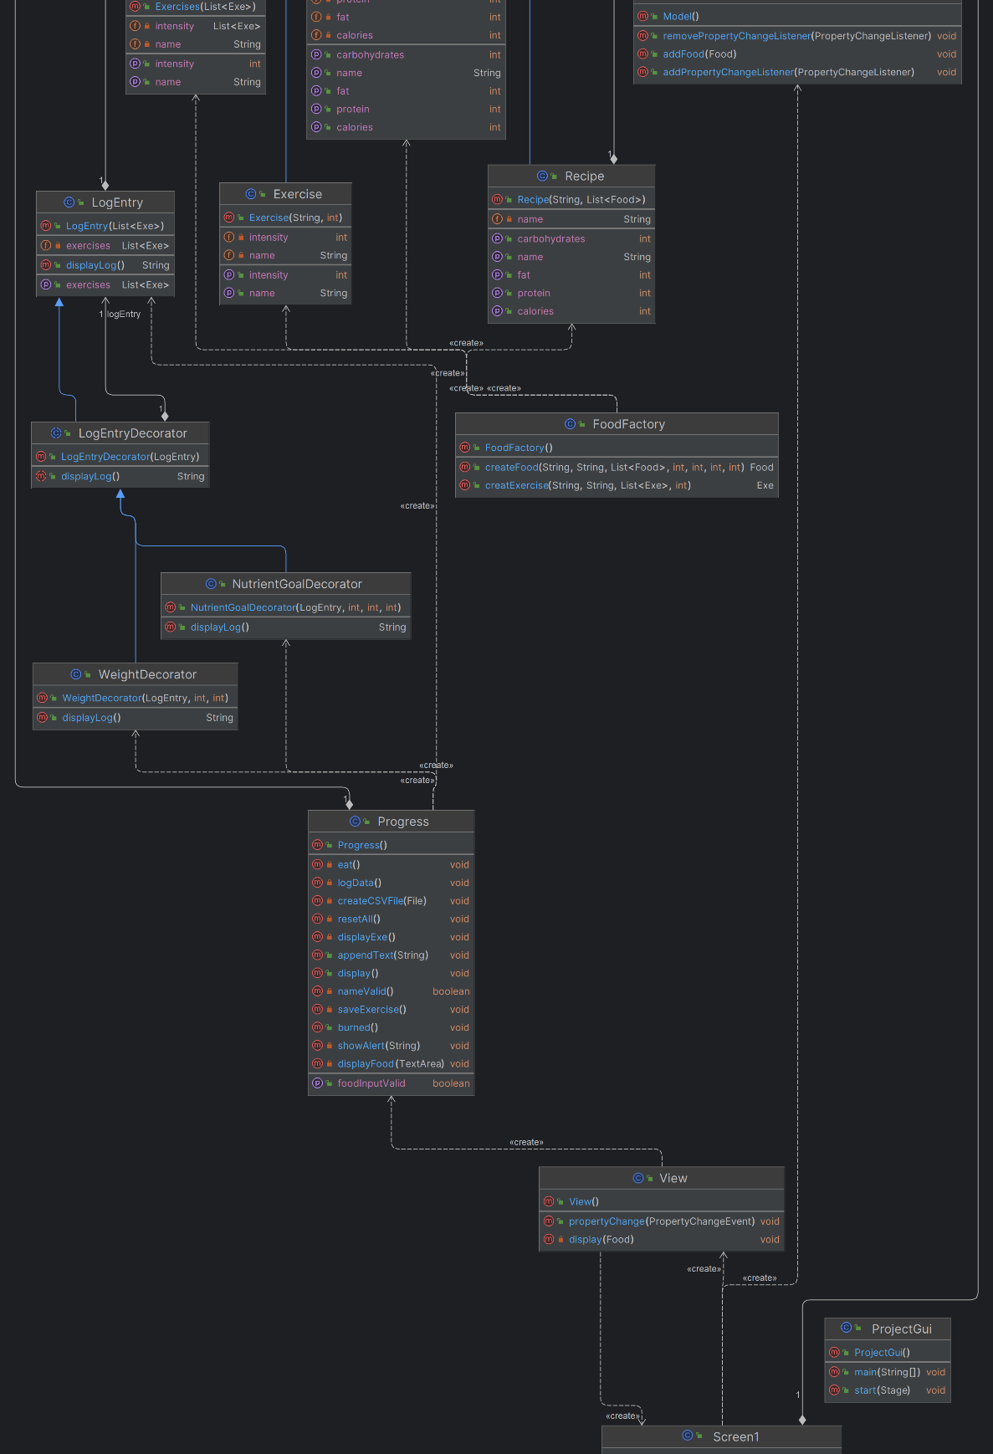
Uml diagram

Slide 6
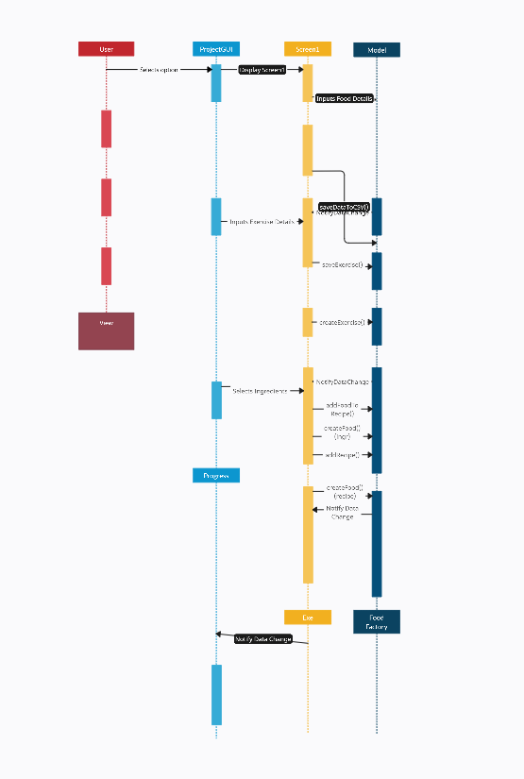
SEQUENCE
DIAGRAM

Slide 7
DEMO

